Slide 1
Supervised Vs Unsupervised
Summary

Slide 2
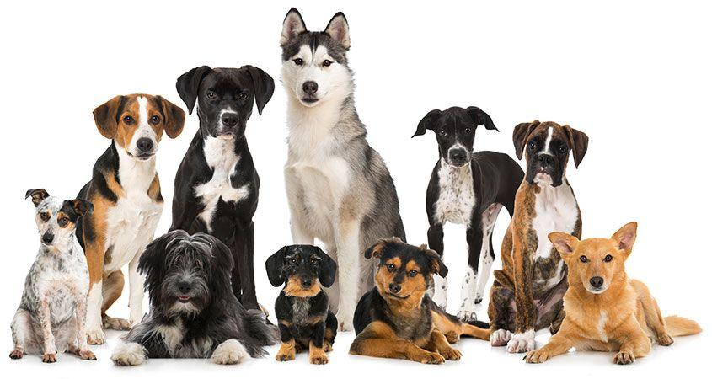
Scenario1
You are a kid, you see different types of animals, your father tells you that this particular animal is a dog…after him giving you tips few times, you see a new type of dog that you never saw before - you identify it as a dog and not as a cat or a monkey or a potato.

Slide 3

Scenario2
You go bag-packing to a new country, you did not know much about it - their food, culture, language etc. However from day 1, you start making sense there, learning to eat new cuisines including what not to eat, find a way to that beach etc.

Slide 4
Supervised
Is like learning with a teacher
Training dataset is like a teacher
The training dataset is used to train the machine

Slide 5
Supervised - Example
Classification: Machine is trained to classify something into some class.
classifying whether a patient has disease or not
classifying whether an email is spam or not
Regression: Machine is trained to predict some value like price, weight or height.
predicting house/property price
predicting stock market price

Slide 6
Unsupervised
is like learning without a teacher
the machine learns through observation & find structures in data

Slide 7
Unsupervised - Example
Clustering: A clustering problem is where you want to discover the inherent groupings in the data
such as grouping customers by purchasing behavior
Association: An association rule learning problem is where you want to discover rules that describe large portions of your data
such as people that buy X also tend to buy Y

Slide 8
Supervised
Supervised learning is where you have input variables (x) and an output variable (Y) and you use an algorithm to learn the mapping function from the input to the output.
Y = f(X)
The goal is to approximate the mapping function so well that when you have new input data (x) that you can predict the output variables (Y) for that data.

Slide 9
Unsupervised
Unsupervised learning is where you only have input data (X) and no corresponding output variables.
The goal for unsupervised learning is to model the underlying structure or distribution in the data in order to learn more about the data.

Slide 10
Sources
https://www.quora.com/What-is-the-difference-between-supervised-and-unsupervised-learning-algorithms
https://machinelearningmastery.com/supervised-and-unsupervised-machine-learning-algorithms/

